Slide 1
SOA Basics
SSE USTC
Qing Ding

Slide 2
Topics
Quick introduction to SOA
Composite applications
Services and SOA

Slide 3
Quick Introduction to SOA

Slide 4
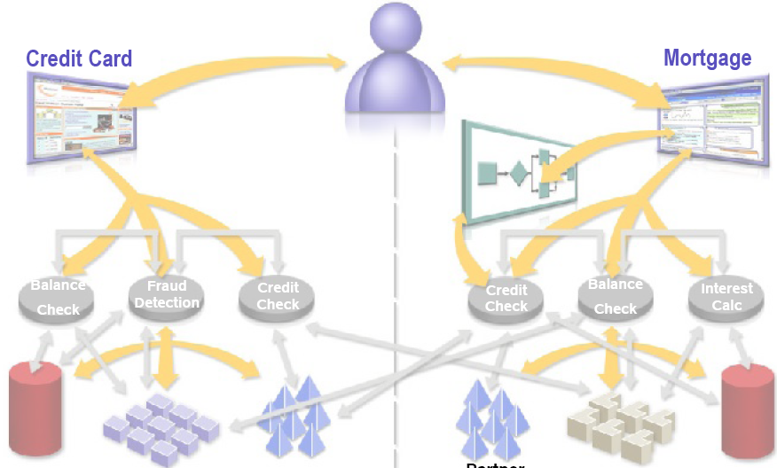
Pre-SOA Scenario
Customer
Data
Back-
End
System
Partner
Credit
Data
Partner
Credit
Data
Back-
End
System
Customer
Data

Slide 5
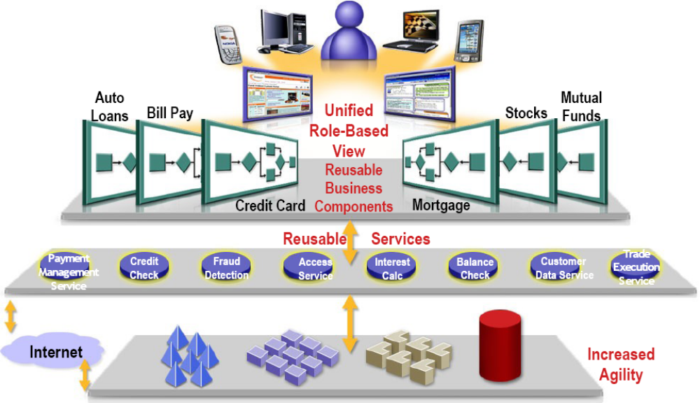
SOA-Enabled Scenario
Partner Credit
Data
Back-End
System
Back-End
System
Customer
Data

Slide 6
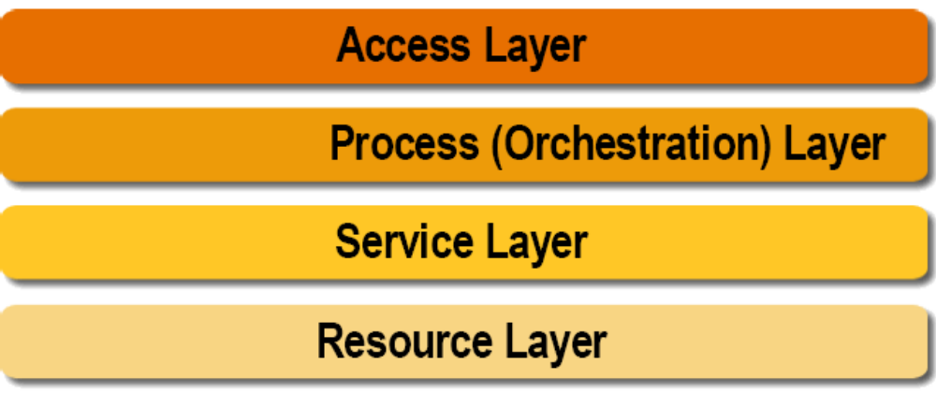
SOA Layers
Shared Network-based Layered Services

Slide 7
Benefits of SOA
Flexible (Agile) IT
  Adaptable to changing business needs
Faster time to market
  Reuse existing code, minimize new development
Business and process-driven
  New business opportunities
Greater ROI
  Leverage existing IT asset

Slide 8
Service Oriented Architecture (SOA)
An architectural principle for structuring systems into coarse-grained services
Technology-neutral best practice
Emphasizes the loose coupling of services
New services are created from existing ones in a synergistic fashion
Strong service definitions are critical
Services can be re-composed when business requirements change

Slide 9
Composite Applications

Slide 10
Applications
Developers need to build end-to-end applications
  Front-end user interfaces
  Middle-tier business logic
  Back-end resources
With the right approach, developers can...
  Reuse existing parts
  Build new parts
  Glue old and new parts together
With the wrong approach, developers must...

Slide 11
Applications
Real-world applications are...
  ...not Web applications
  ...not Java EE applications
  ...not Swing forms
  ...not Web services
  ...not BPEL processes
  ...not SOA
  ...not JBI
  ...not RDBMSs
  ...not (your favorite technology)
Real-world applications use many or all of these

Slide 12
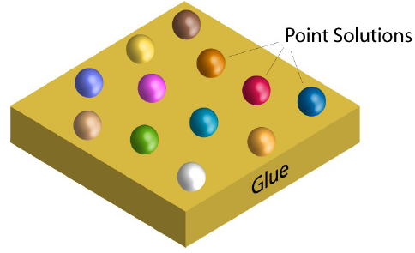
Traditional Application Development
Point technologies, products, and APIs
  For example: EJB, Spring, Hibernate, JSF, Servlets, Struts, etc.
Lots of glue written by developers
  Requires a great deal of expertise & time
  Inflexible

Slide 13
Composite Applications
A way to compose applications from reusable parts
Composite applications employ SOA principles
  Features exposed as Web services
  Standards-based interaction between services
  Are themselves composable

Slide 14
Services and SOA

Slide 15
What Are Services?
Black-box components with well-defined interfaces
  Performs some arbitrary function
  Can be implemented in myriad ways
Accessed using XML message exchanges
  Using well-known message exchange patterns (MEPs)
Metadata in the form of WSDL describes...
  Abstract interfaces
  Concrete endpoints

Slide 16
What Can Services Do?
Perform business logic
Transform data
Route messages
Query databases
Apply business policy
Handle business exceptions
Prepare information for use by a user interface
Orchestrate conversations between multiple services

Slide 17
How Are Services Implemented?
Enterprise JavaBeans™ (EJB™) technology
BPEL
XSLT
SQL
Business rules
Mainframe transaction
EDI transform
Humans (yes, really!)
…

Slide 18
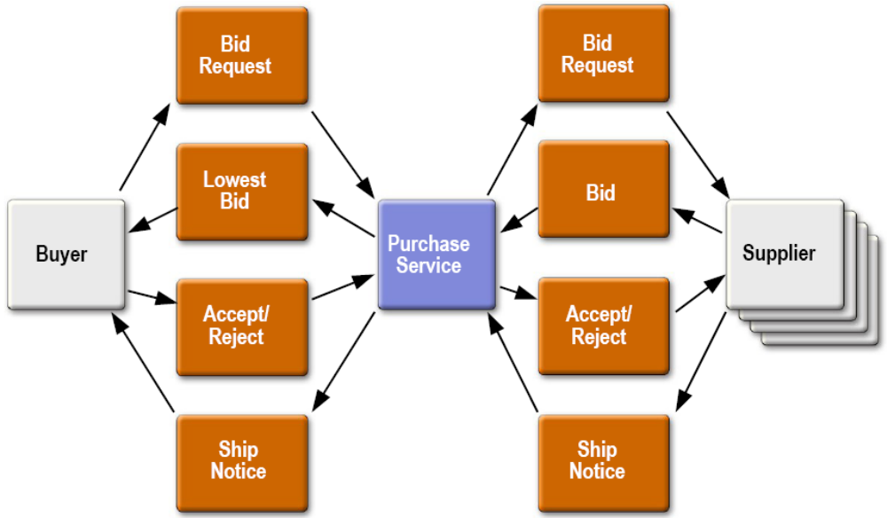
Example: Purchase Service

Slide 19
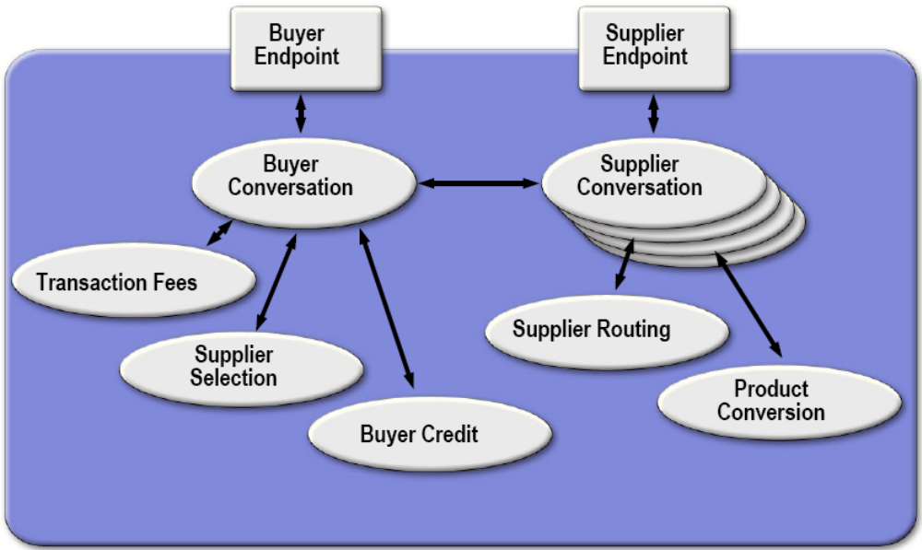
Purchase Service Functions

Slide 20
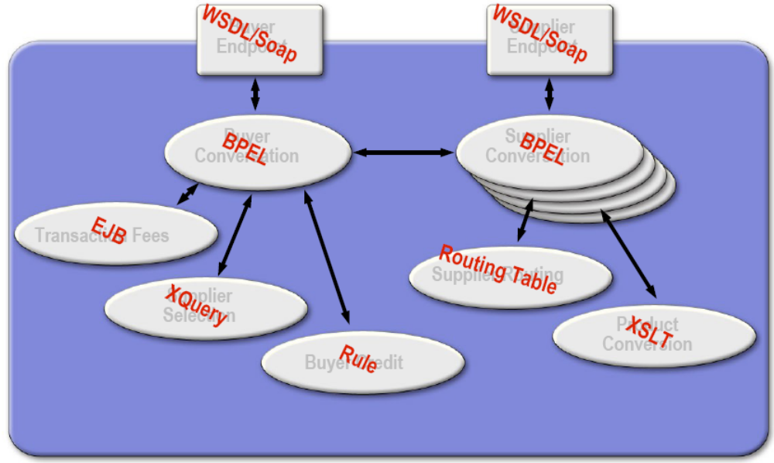
Purchase Service Functions

